Slide 1
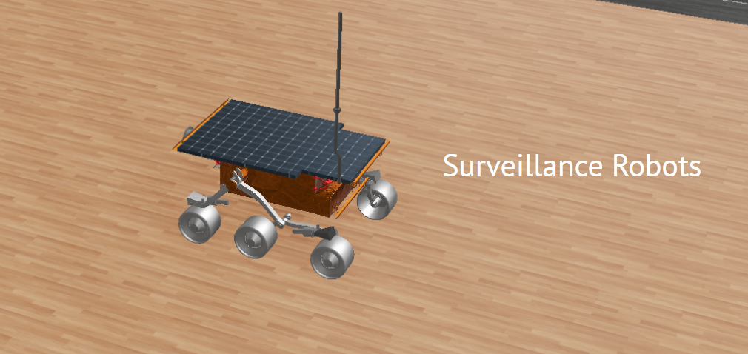
The Surveillance Robot
By Ganesh Rajure

Slide 2
Why the Surveillance robots are needed?
Law enforcement people are working under heavy workload

Slide 3
Project
https://sites.google.com/view/dhaalcomplete-defence
Website

Slide 4
Root To Reach the Destination
Catch the problem (Interview)
Analyse the problem(Problem Statement)
Find the solution(Through Simulation)
Find the appropriate Solution
Build Demo
To get ready our project!

Slide 5
Interviews Conducted

Slide 6
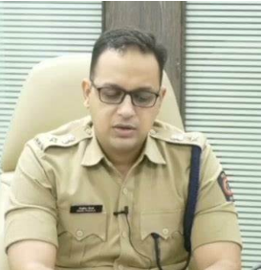
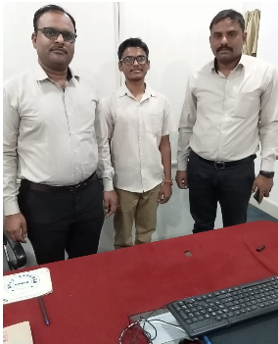
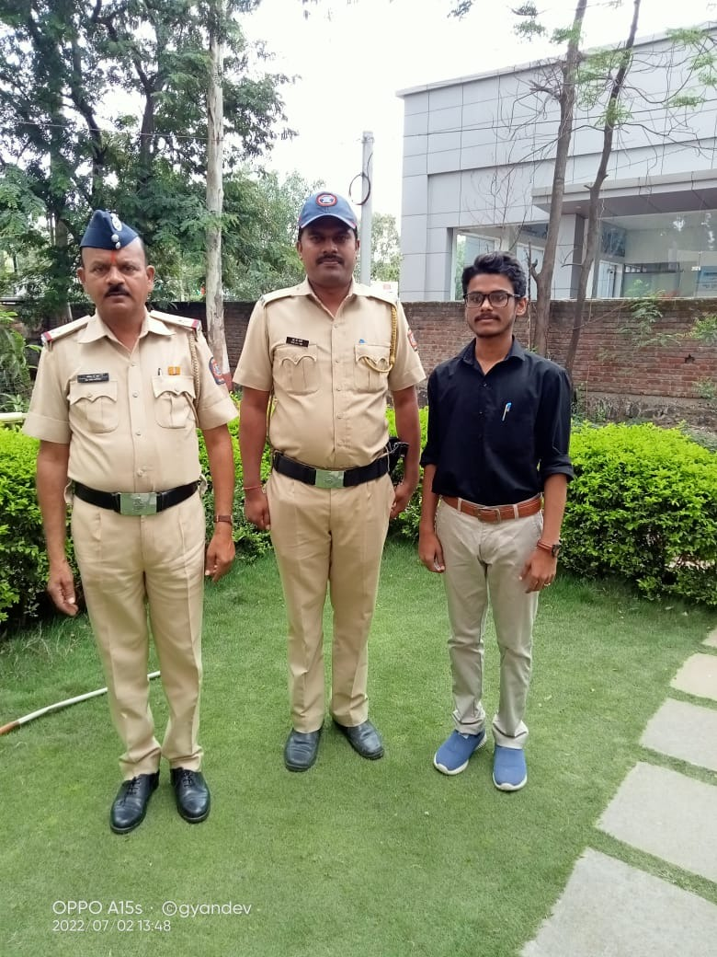
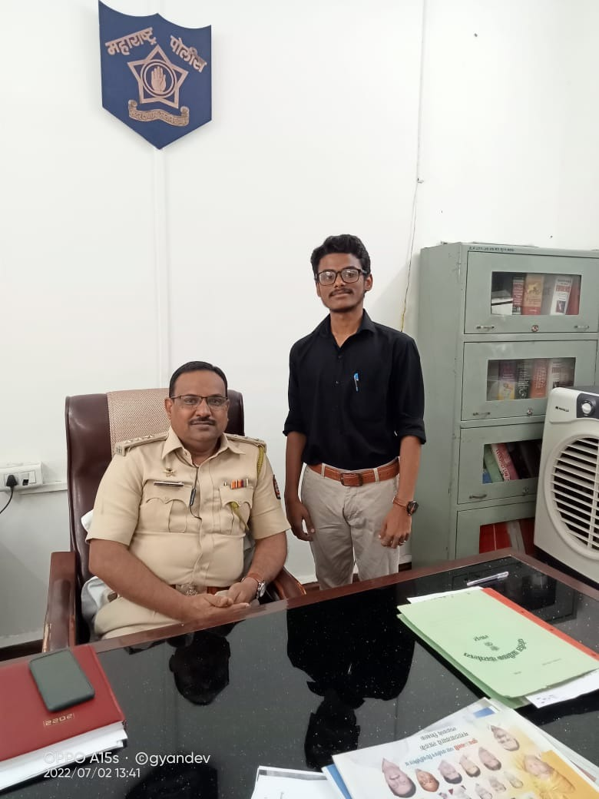
Procedure
I had started reaching out to the people related to the police department and security functioning.
I took the appointments through mails and the contacts.
Prepared Questions which was suggested by my mentor.
Finally took the Inetrview for the problem definition.

Slide 7
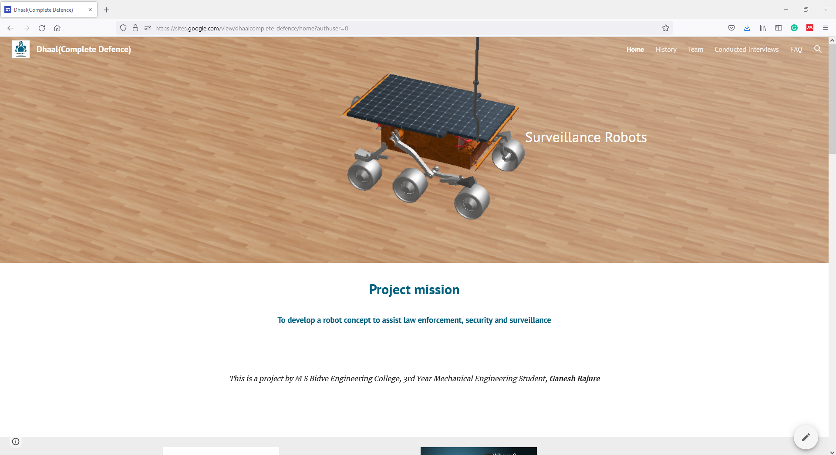
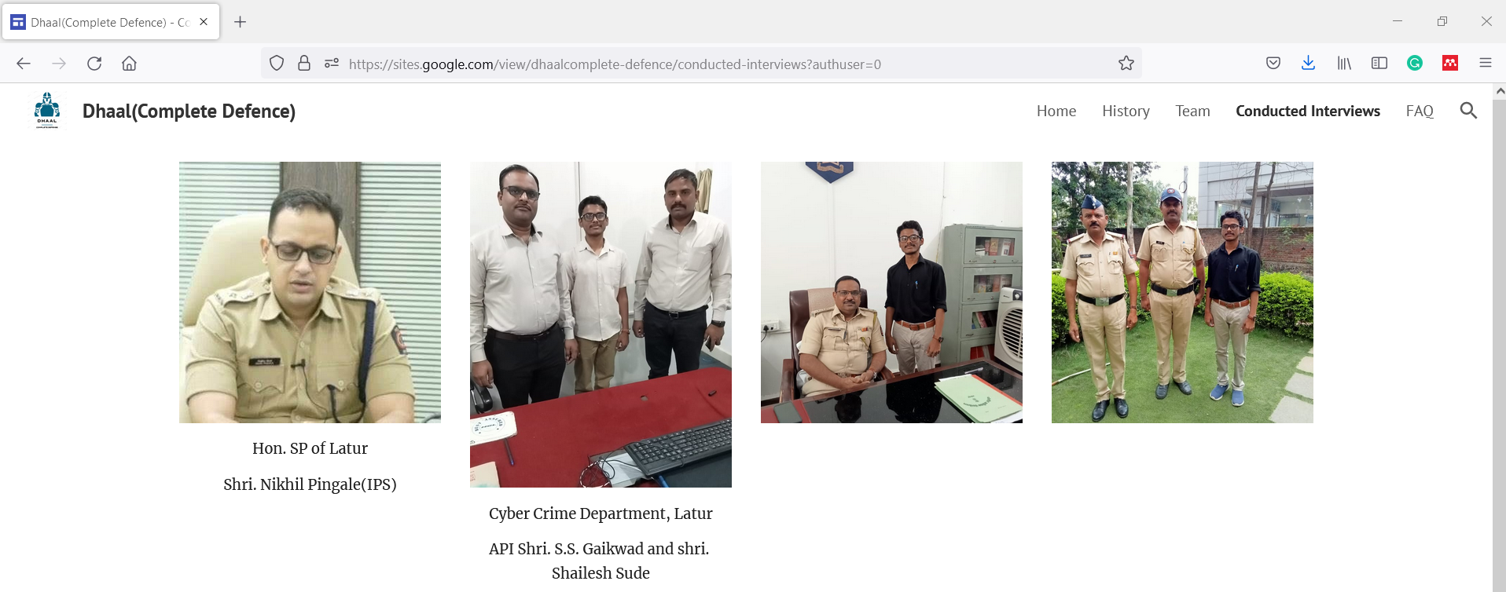
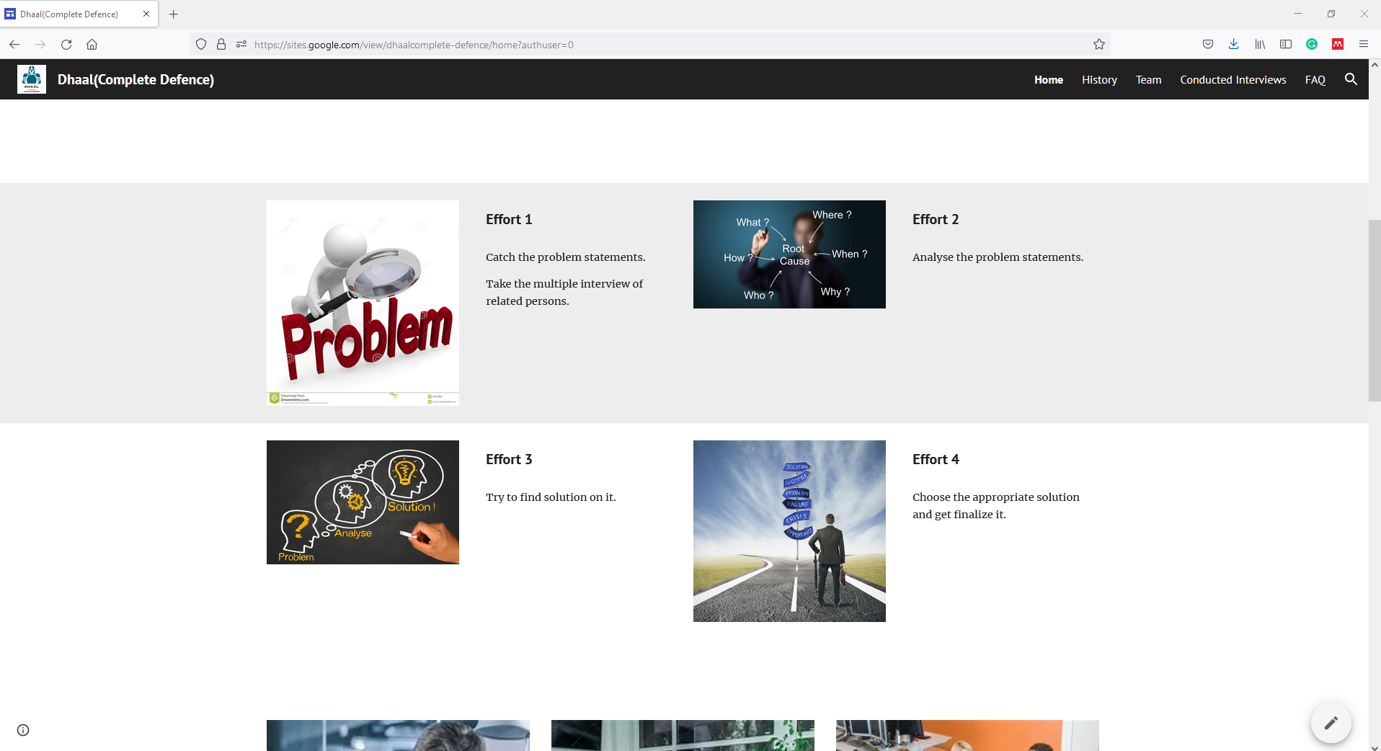
Created Website
To document all of the efforts
Learnt website creation
Published Content

Slide 8
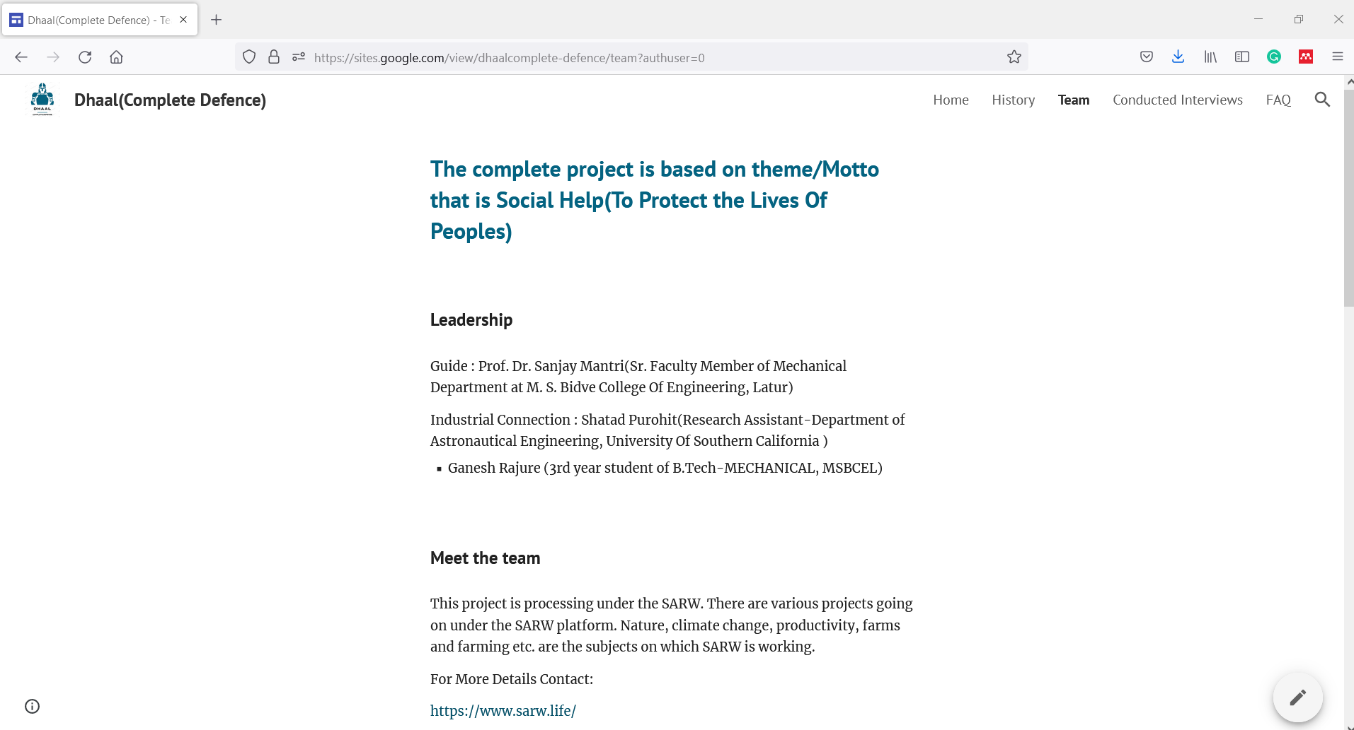
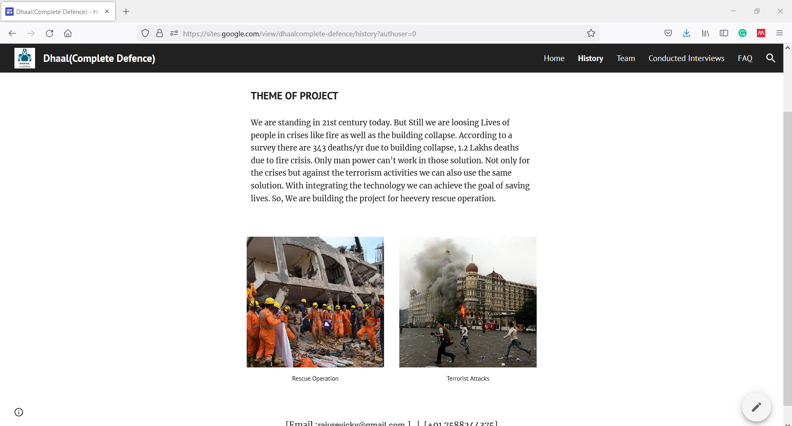
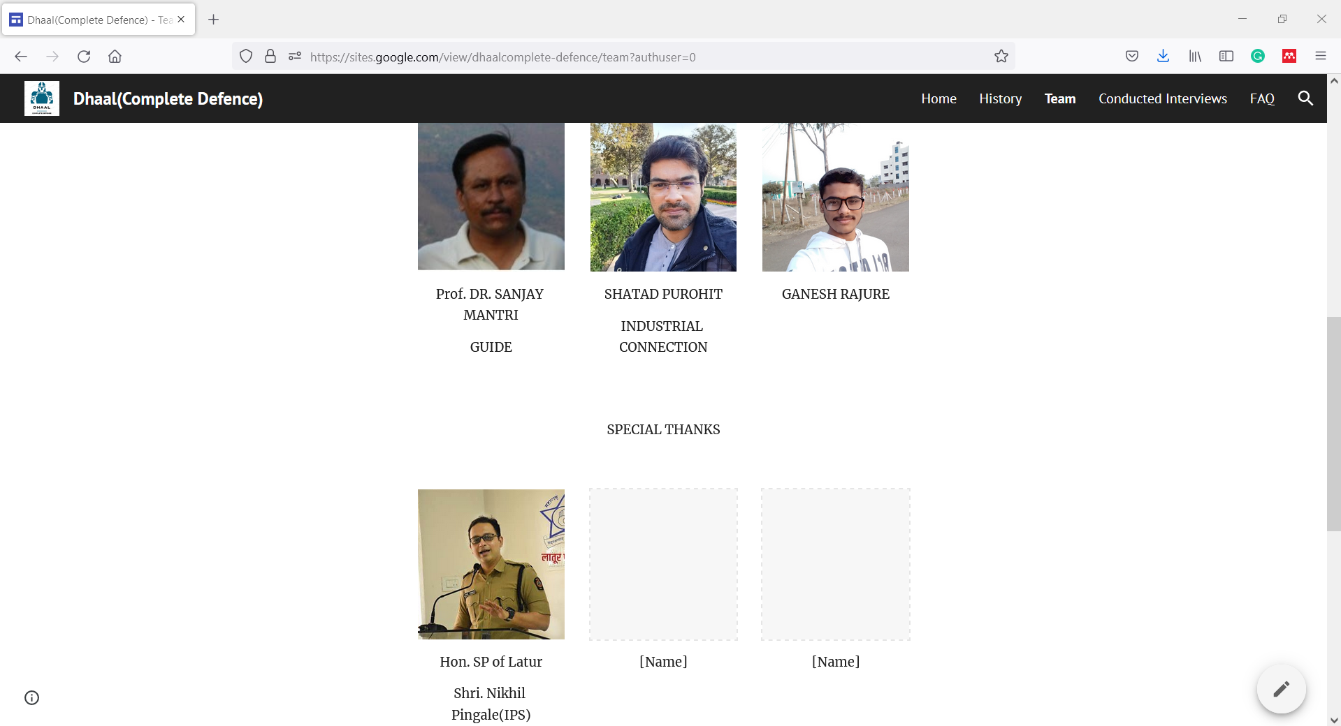
Created Website
Website helped in communicating my efforts and getting interviews

Slide 9
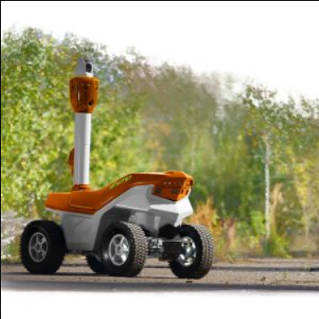
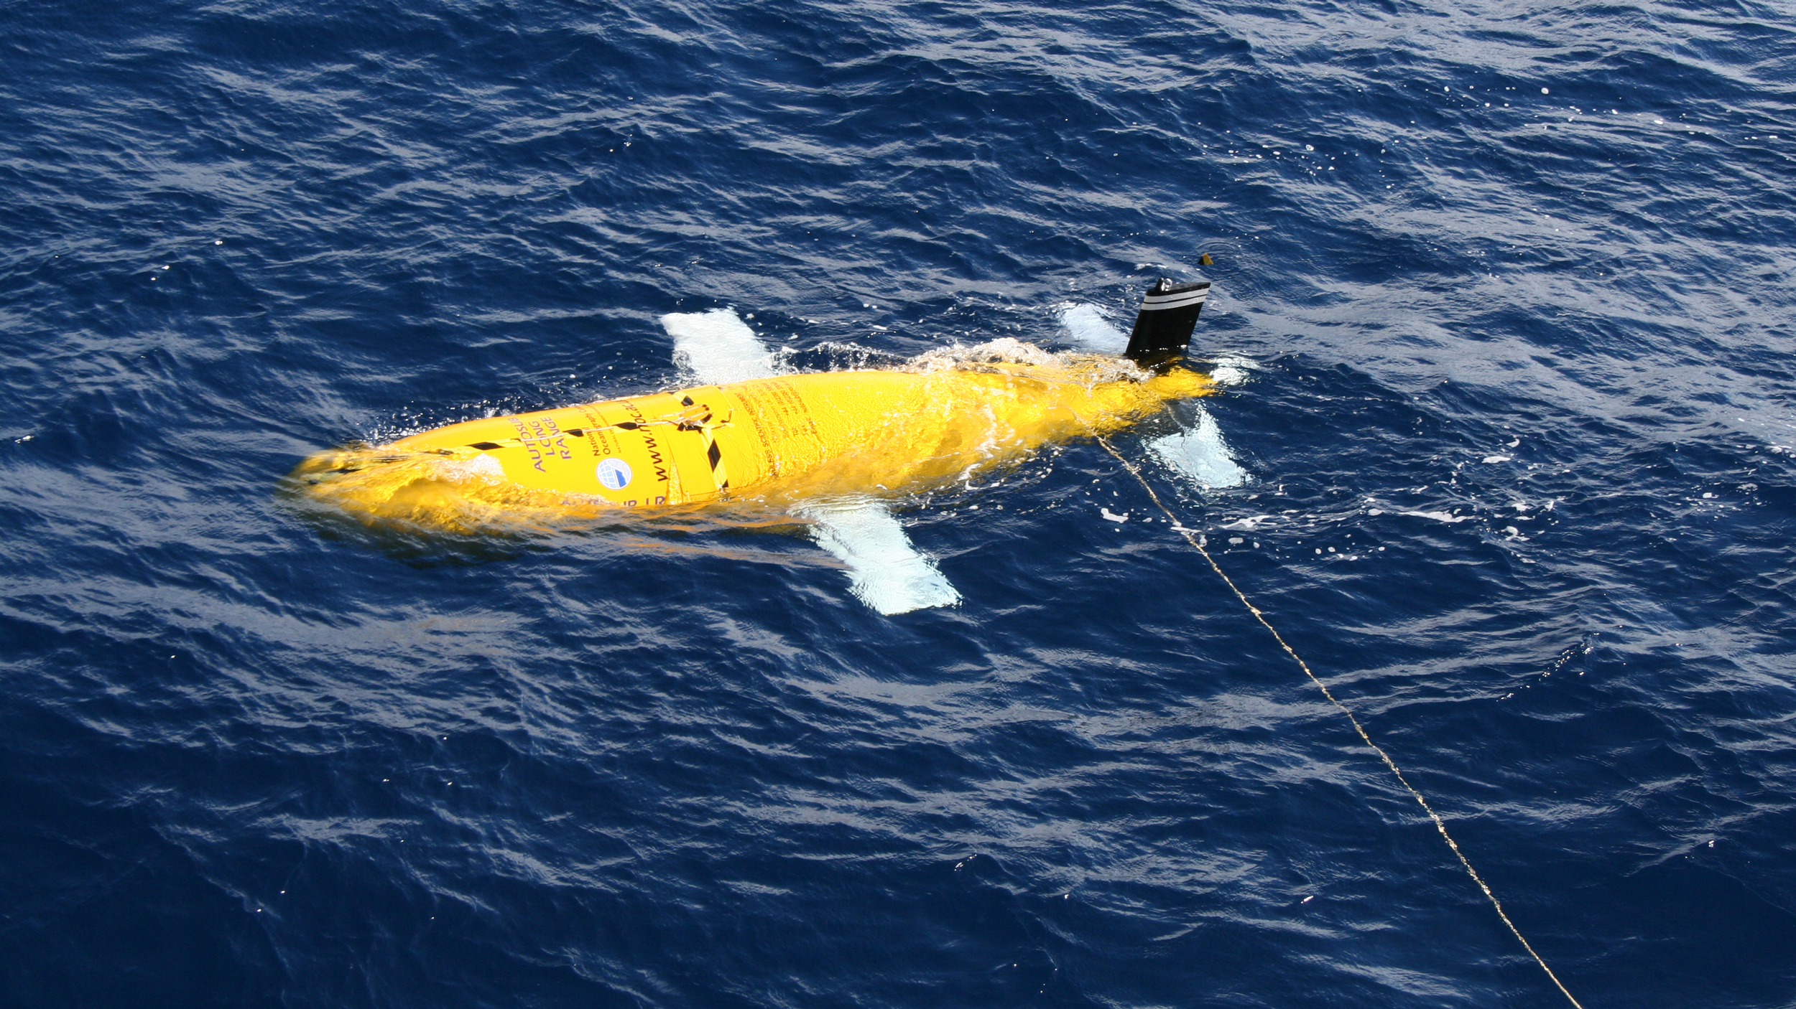
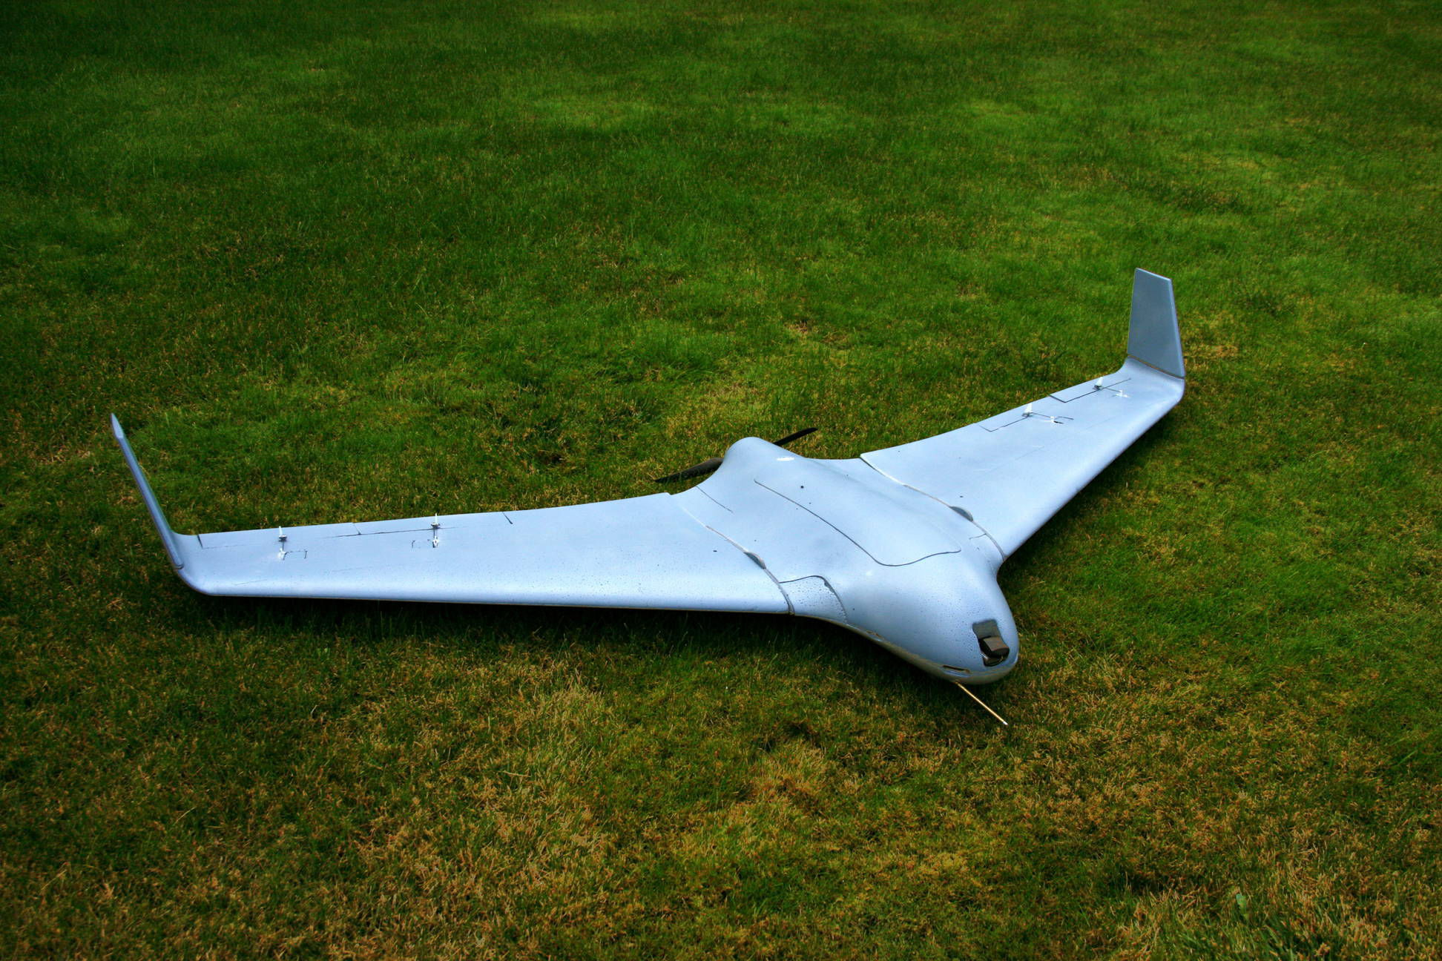
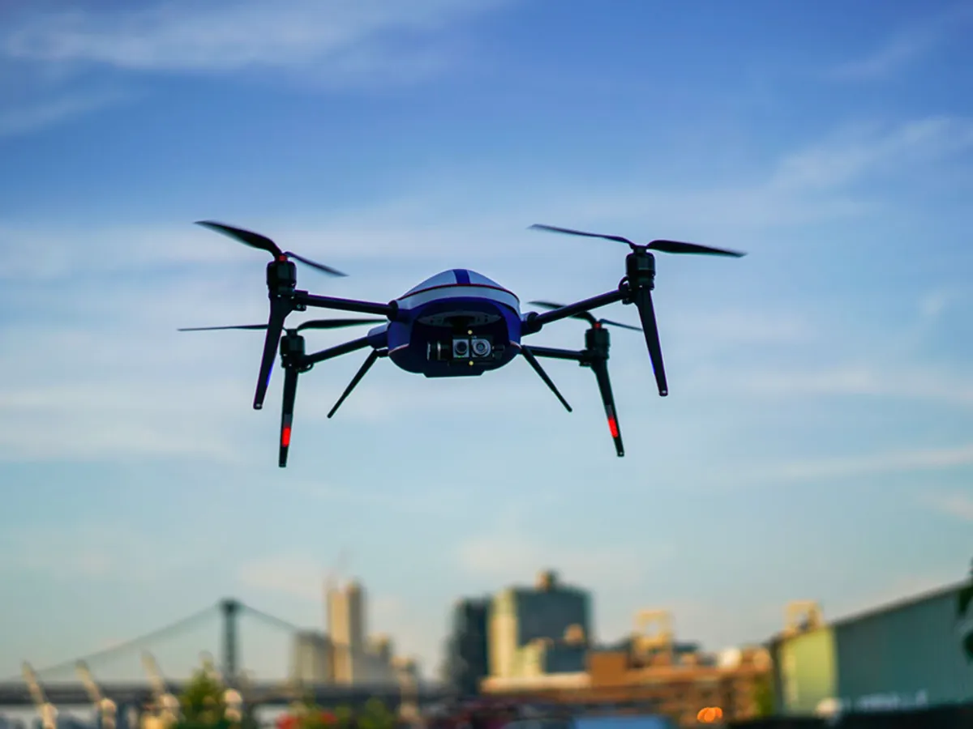
Studied Existing Surveillance Robots
There are multiple types of robots used for surveillance
Ground Robots
Flying Robots (Drone)
Water Robots
Many agencies across the world use it for surveillance to reduce workload on humans.

Slide 10
Problem Analysis

Slide 11
Tell the audience what you expect to happen...

Slide 12
Problem Analysis
I think this is needed because…As we conducted this interviews they told us that there is deficiency of human power in the department. According to the law and order maintenance criteria they are facing huge load because of the various circumstances. I had conducted the interviews in the rural area. So, peoples are unaware about the technology. While petrolling activity as well as the various activities where the robots can be used for enhancing the activity
Variables that may affect the outcome...
Unawareness of technology
Cyber Security

Slide 13
The Simulation For the Solution

Slide 14
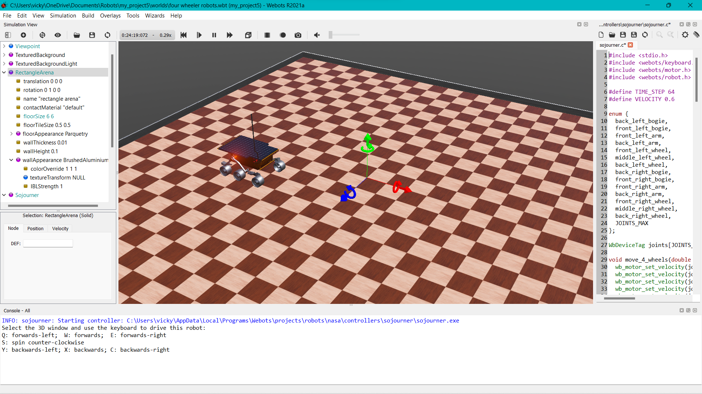
The project simulation

Slide 15
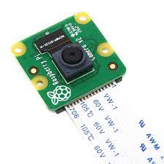
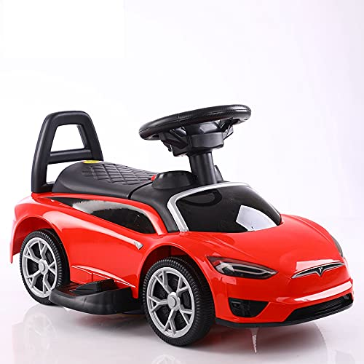
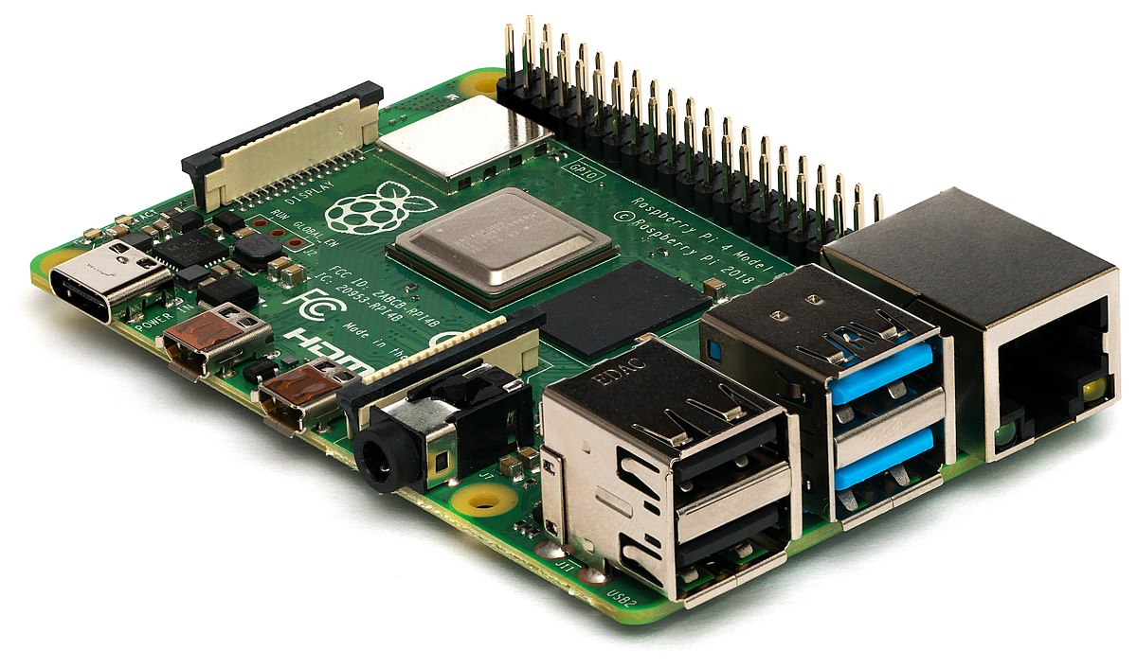
Studying – How to Create Demo
Searching for Hardware
Electric Car
Raspberry-Pi
Pi Camera Sensor
Collecting Funds = 6000 Rs

Slide 16
Conclusion
Till date I had achieved my goal as the simulation only. I am trying my best to develop this model as the physical one. I am very thankful to my guide Prof. Dr. Sanjay Mantri Sir and Mr. Shatad Purohit (Research Assistant & Ph. D. Candidate, Department of Astronautical Engineering, USC). Special thanks to Hon. SP of Latur District IPS Shri Nikhil Pingale.

